Slide 1

Data Analytics Makeathon 2.0
GROUP 1

Slide 2

INTRODUCTION
A brief Analysis of a movie data set.
TABLE OF CONTENT
18 SQL queries
2 Dashboards
Insights and Recommendations

Slide 3

QUERY 1

Slide 4
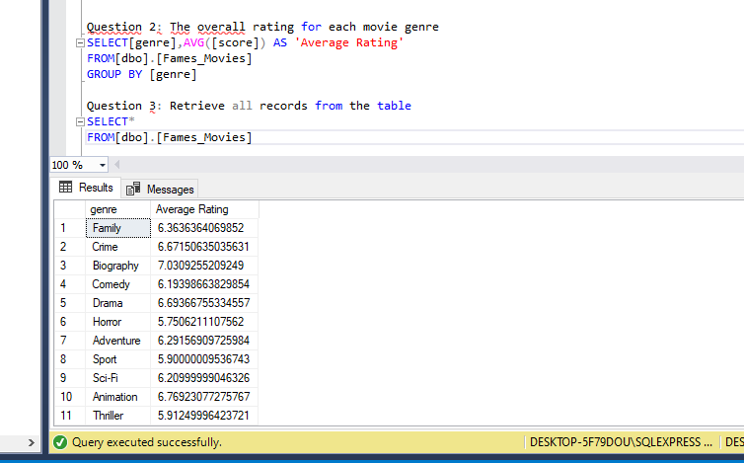
QUERY 2

Slide 5
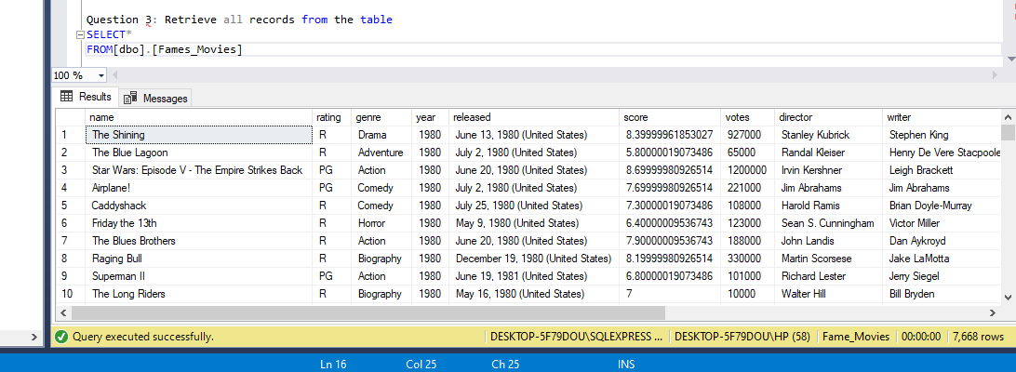
QUERY 3

Slide 6
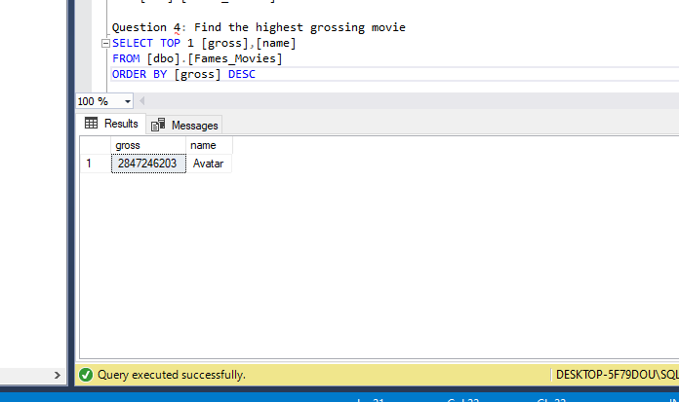
QUERY 4

Slide 7
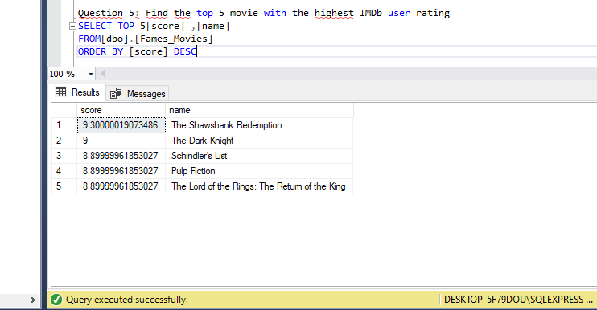
QUERY 5

Slide 8
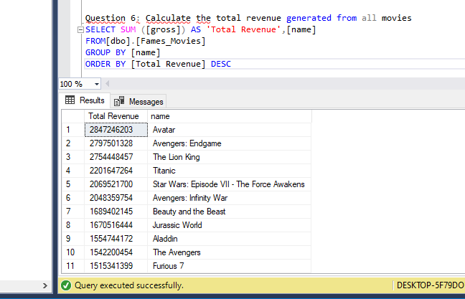
QUERY 6

Slide 9
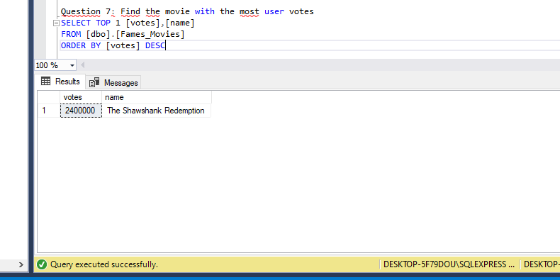
QUERY 7

Slide 10
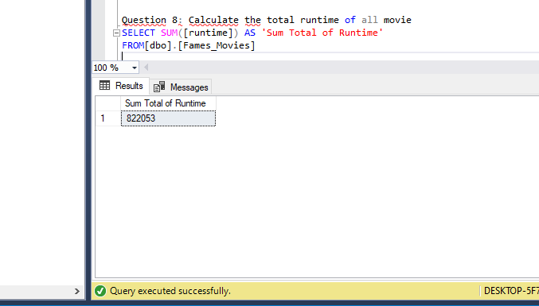
QUERY 8

Slide 11
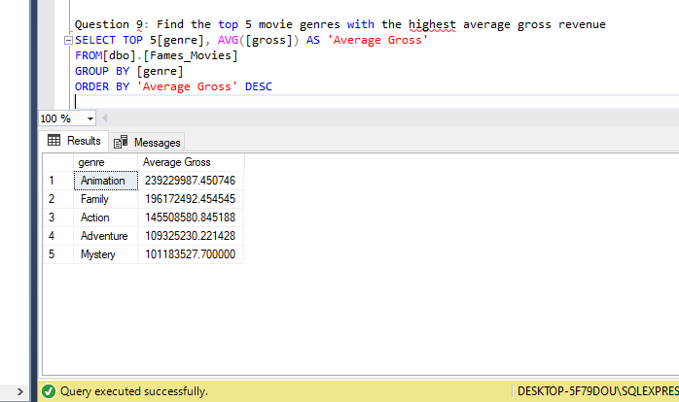
QUERY 9

Slide 12
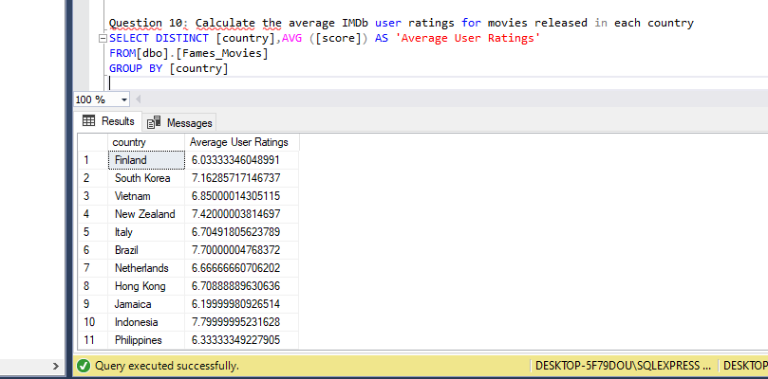
QUERY 10

Slide 13
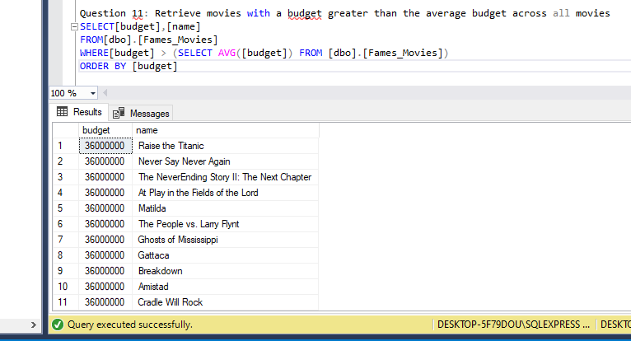
QUERY 11

Slide 14
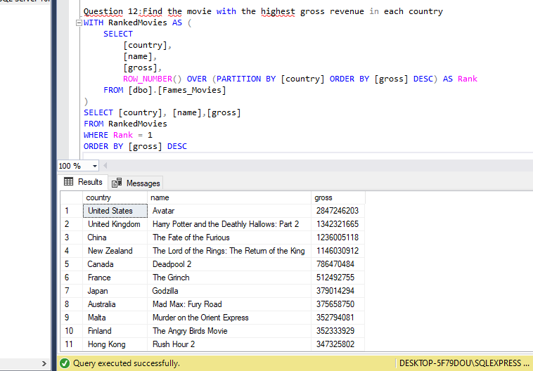
QUERY 12

Slide 15
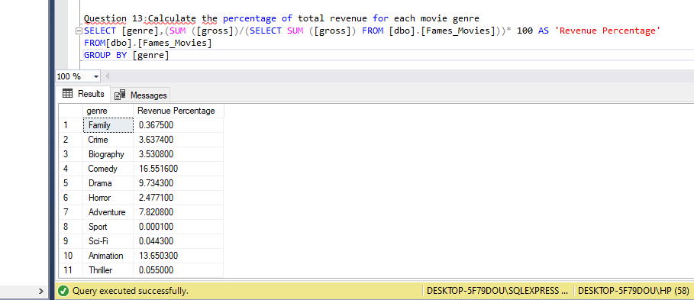
QUERY 13
]

Slide 16
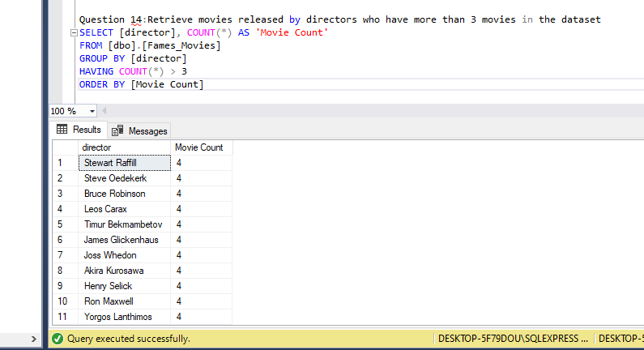
QUERY 14

Slide 17
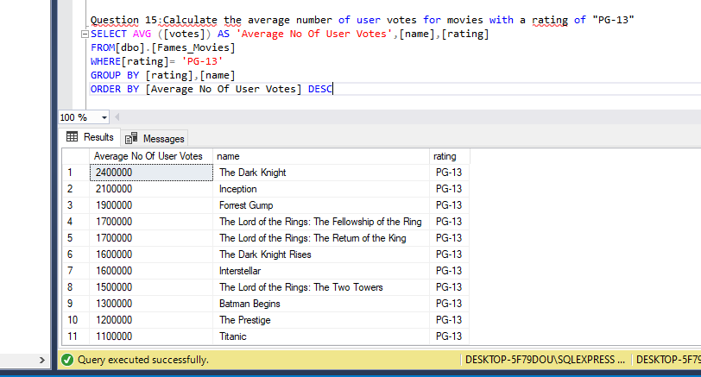
QUERY 15

Slide 18
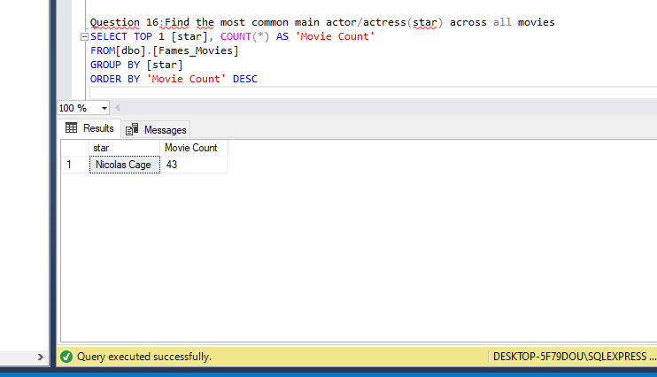
QUERY 16

Slide 19
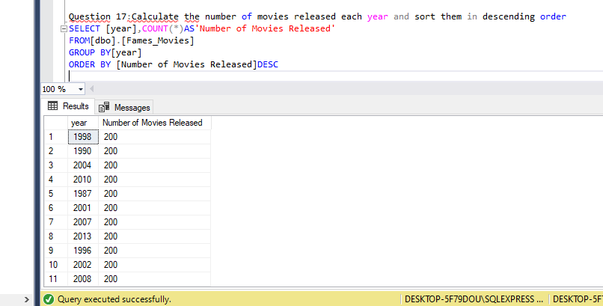
QUERY 17

Slide 20
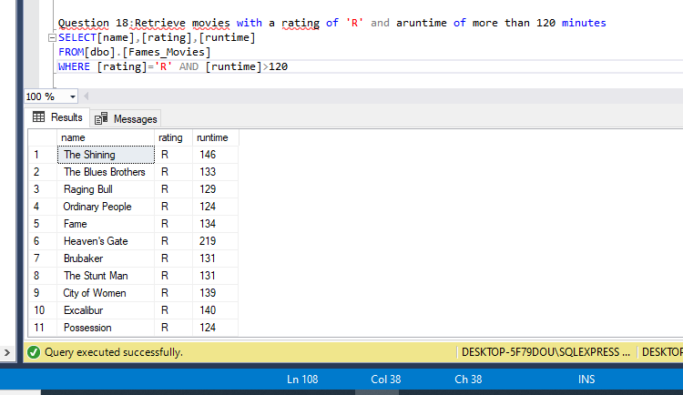
QUERY 18

Slide 21
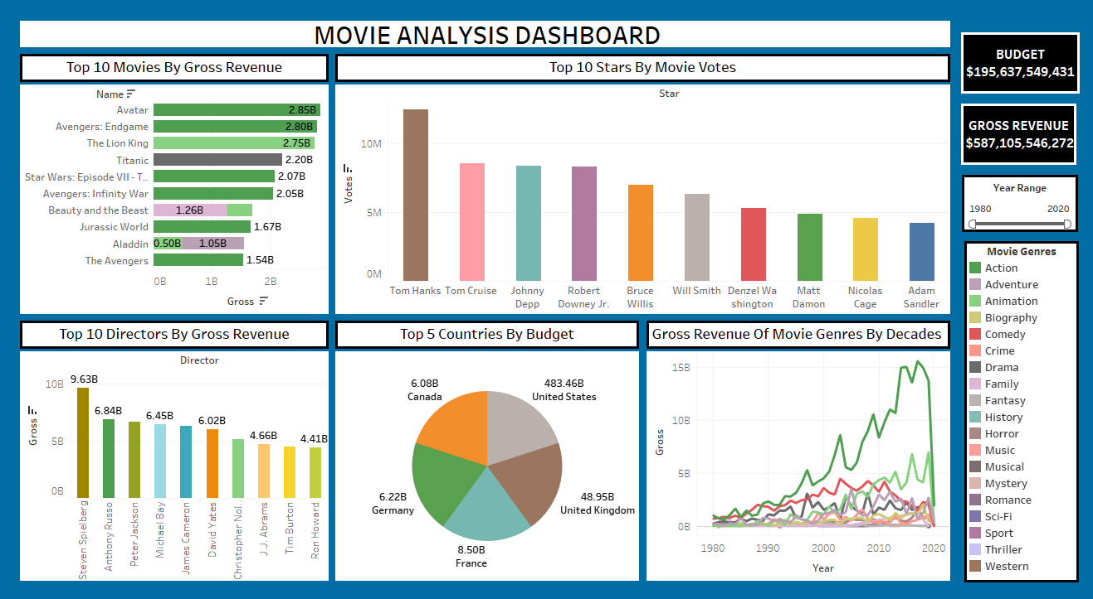

Slide 22
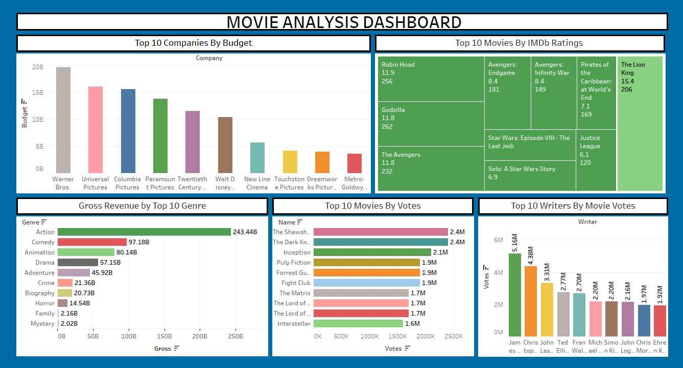

Slide 23
INSIGHTS AND RECOMMENDATIONS
1. Top 10 Movies By Gross Revenue
INSIGHT
This chart shows that the top 10 movies that generated the highest revenue based on the dataset being analyzed.
These movies fall under the "Action, Animation, Drama and Family” Genre which shows that those genres are the most watched by viewers.
RECOMMENDATION
Companies should invest more in producing movies within these genres to thrive and generate more Revenue.

Slide 24
2. Top 10 Stars by Movie Votes
INSIGHT
The star topping this chart is "Tom Hanks”. It would have been easy to think that he probably featured in more of Action movie genre since the Action movie genre is the top genre. However, what made him standout in comparison to other movie stars was his appearances in different movie genres. He featured mostly in Drama movie genre which has the most vote of about 3.73Million.
RECOMMENDATION
Other movie stars should work more on featuring in movies that cuts across different genres.

Slide 25
3. Top 10 Directors by Gross Revenue
INSIGHT
This chart reveals the gross revenue of the leading directors in the movie industry, we can deduce that overall, one director was especially diverse taking part in the Action Genre, Adventure Genre, Drama Genre and many more, This diversity generated more revenue for him. The name is this director is Stephen Spielberg.
RECOMMENDATION
Directors should focus on diversity in genres when selecting movies to direct in order to stand out and increase chances of recognition.

Slide 26
4. Top 5 Countries with the Highest Revenue
INSIGHT
This chart shows the top 5 countries that generated the most revenue from movies produced. Observation: These companies diversified by producing movies that cuts across different genres. Having The United States topping the chart, being the country with the most diversified genre.
RECOMMENDATION
Diversification in producing movies across various genres would boost companies performance and revenue.

Slide 27
5. Gross Revenue by Decades and Genres
INSIGHT
This chart reveals that the Action movie genre has slowly inclined in revenue over the last 4 decades, generating the highest revenue of $15.60billion particularly in year 2017 but has slowly declined towards year 2020 with a revenue of $1.94billion. The Animation and Comedy genres have also contributed significantly to the Gross revenue over the decades.
RECOMMENDATION
Directors should focus on diversity in genres when selecting movies to direct in order to stand out and increase chances of recognition.

Slide 28
6. Top 10 Companies By Budget
INSIGHT
This chart reveals the budget of the leading companies in the movie industry, we can deduce that ‘Warner Bros’ company was especially diverse by creating budget across different movie genres with the Action genre taking up to about 56% of the total budget of the company while other genres like Animation, Adventure, Comedy, Crime amongst other takes up the 44% of the company’s budget.
RECOMMENDATION
Companies should focus on diversifying in terms of movie genres especially in Action genre when creating a budget, in order to ensure profitability and sustainability.

Slide 29
7. Top 10 Movie By IMDb Ratings (Scores)
INSIGHT
This chart reveals that “The Lion King” movie having the highest rating falls under Animation genre, while the rest of the 9 Movies falls purely under the Action genre.
This clearly depicts the interest of viewers.
The runtime of the movies as well had a significant influence on the ratings awarded by viewers.

Slide 30
8. Gross Revenue By Top 10 Genre
INSIGHT
The Action movie generated the highest revenue of about 243.44billion which makes up to 42% of total gross revenue, With other genres such as Comedy, Animation and Drama also contributing to a large percentage of the total gross revenue.

Slide 31
9. Top 10 movies by votes
INSIGHT
The top Genre in this chart might have had more captivating thrillers than the others.
RECOMMENDATION
Other movie producers could work more on their thrillers, and make them more captivating and leave the viewers curious about what will happen next in the movies (which eventually drives them to watching the movie).

Slide 32
10. Top 10 Writers By Movie votes
INSIGHT
The top writers on this chart diversified in writing more of Action genres of movie with a little mix of other genres.
RECOMMENDATION
Other Writers should write more on Action based movies for recognition and industry growth.

Slide 33
PRESENTED BY GROUP 1
THANK YOU!

